Slide 1
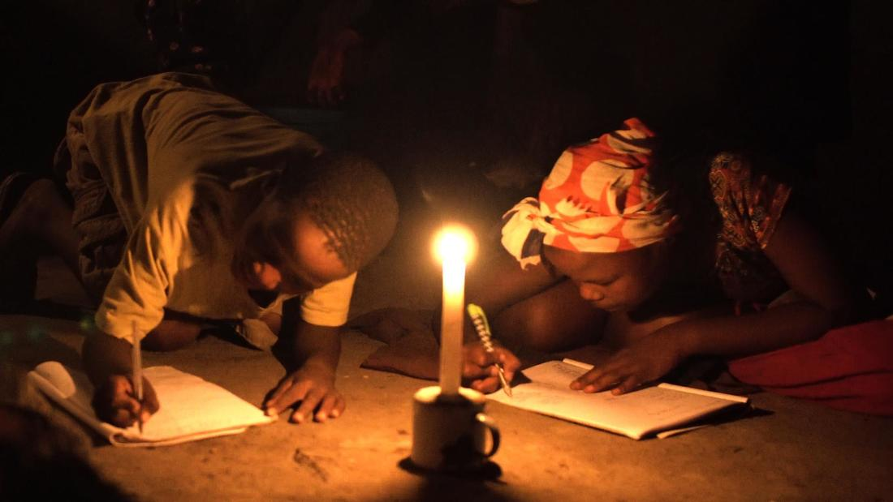
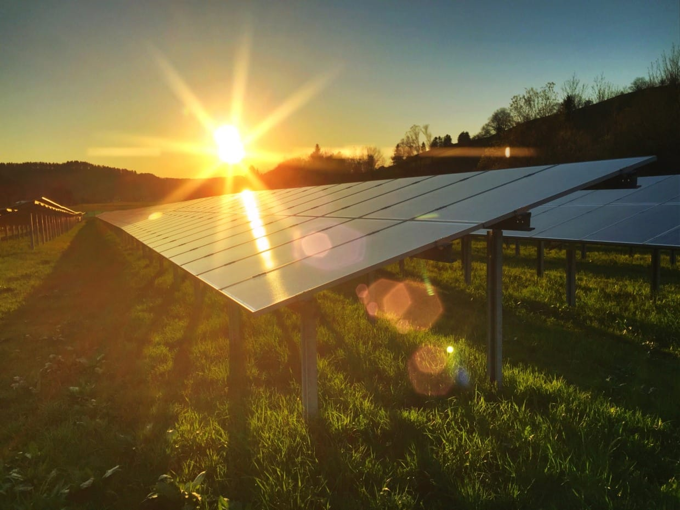
GREEN LIVELIHOODS - NEED PULL SOCIAL INNOVATION
SUNRISE SOLAR ENERGY IN RURAL POPULATION OF ZIMBABWE (United Nation’s SDGs 7 & 13)
Team Members
Tambudzai Gundani (Zimbabwe)
Rebone Mabaso

Slide 2
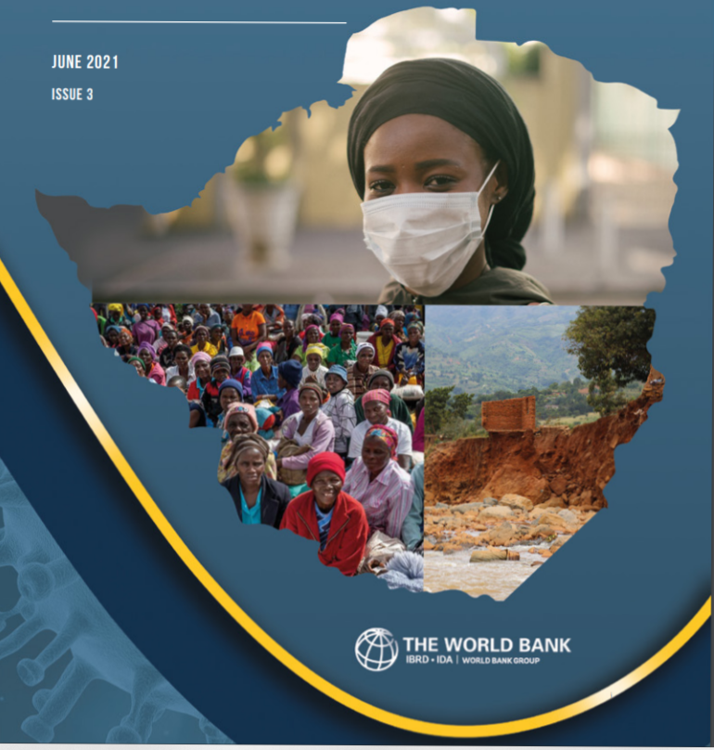
Background
Zimbabwe is a landlocked country located in Southeast Africa between the Zambezi and Limpopo rivers, bordered by South Africa to the South, Botswana to the South-West, Zambia to the North and Mozambique to the East. The country’s population of around 14.86 million is largely rural with 67% of the population resident in rural areas (ZIMSTART, 2020).
Zimbabwe is a lower-middle income nation which heavily relies on mining and agriculture (contributing 30% of GDP). Poverty levels remain relatively high, with an estimated 70.5% of all households in 2017 living in poverty. Nonetheless, Zimbabwe remains one of the countries with the highest literacy rate on the continent, investing about 11% of GDP in education (UN, 2021)
The country has a huge renewable energy resources potential, yet the exploitation of these resources to address energy poverty is highly negligible due to prevailing economic hardships. Such energy potentials includes the untapped Hydro-Electric Power Concentrated in the Zambezi River and Solar Power potential as the country has an average annual of 8.3 sun hours per day (MSD, 2021)
The primary source of energy for cooking in rural areas is firewood, with a statistic of 94% of households using firewood (The Forestry Commission of Zimbabwe, 2020)

Slide 3
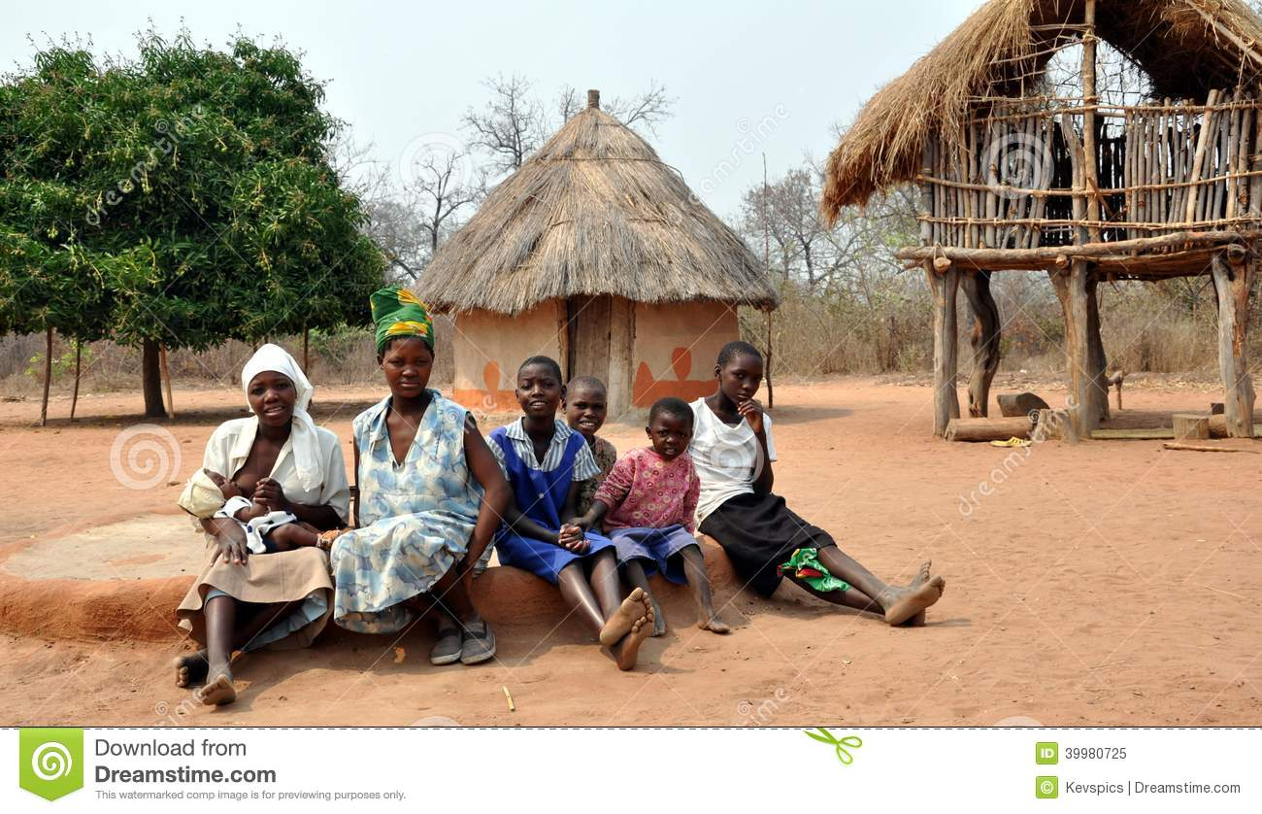
The Local Society: Gokwe South
Located in the central part of the country is the Midlands province in it is a remote Rural area Namely Gokwe South with a population of 305,982 people (ZIMSTAT, 2020). Rural Gokwe South is one of the eight administrative districts of the Midlands province.
Of the 27 Wards in Gokwe South carrying a total of 305 982 people only a few business centers are electrified while no household have access to electricity. This heavily affect the economic activities in the society, access to remote learning and other technological advancement.
Gokwe is known for being the last to receive any kind of developmental activities, trends or information dissemination due to its remote location and lack of electricity to facilitate effective communication.
In 2010, Gokwe South had 1.06Mha of tree cover, extending over 2.7% of its land area. In 2020, it lost 6.22kha of tree cover, equivalent to 2.84Mt of CO₂ of emissions (Global Forest Watch, 2021). This is as a result of reliance on fuelwood amid lack of electricity.

Slide 4
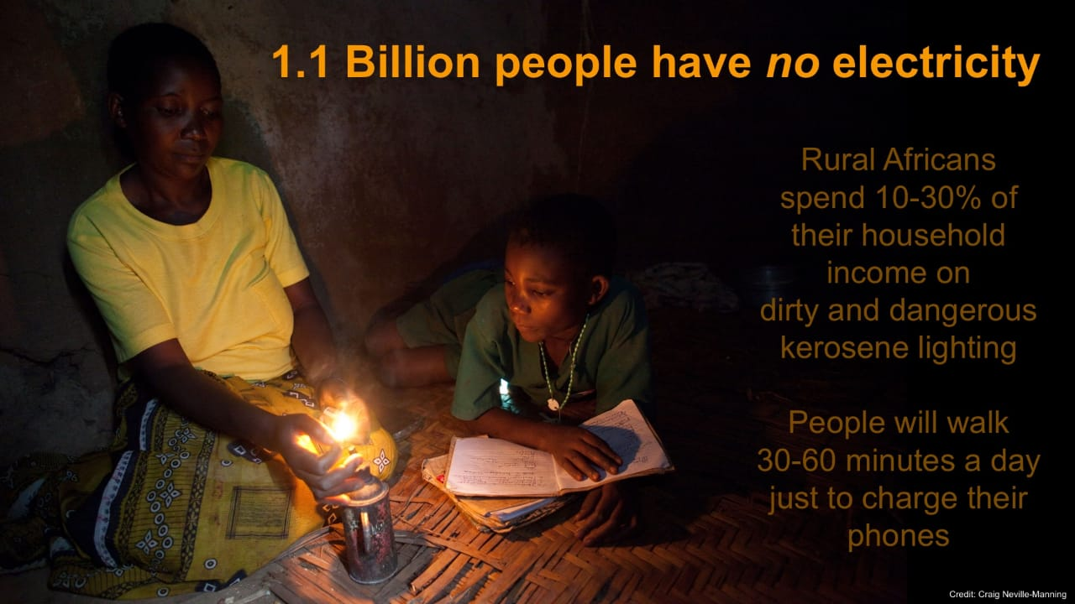
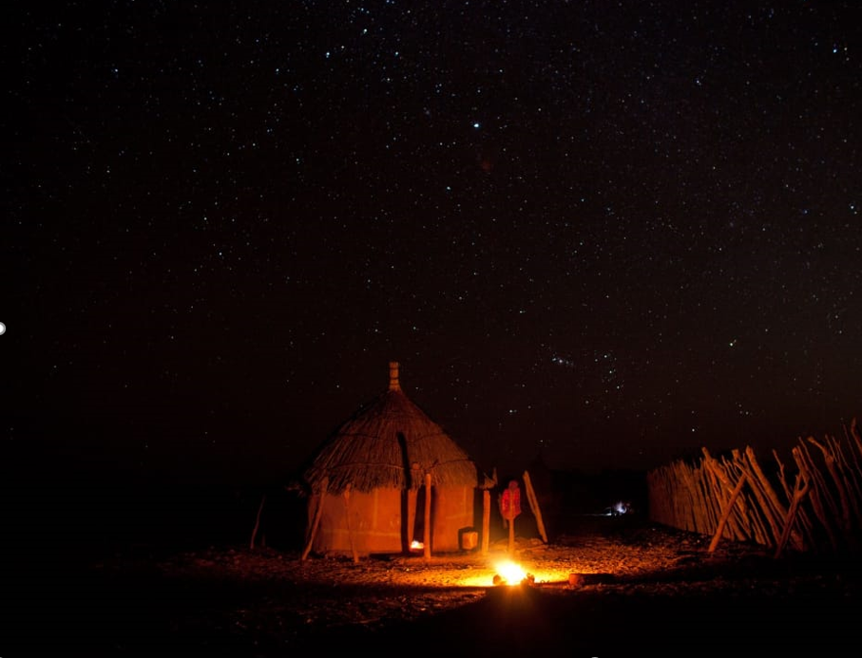

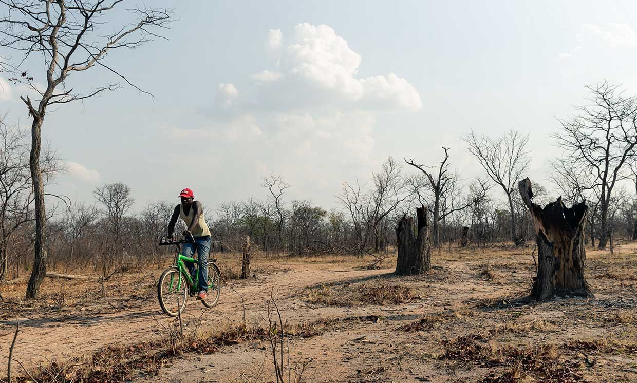
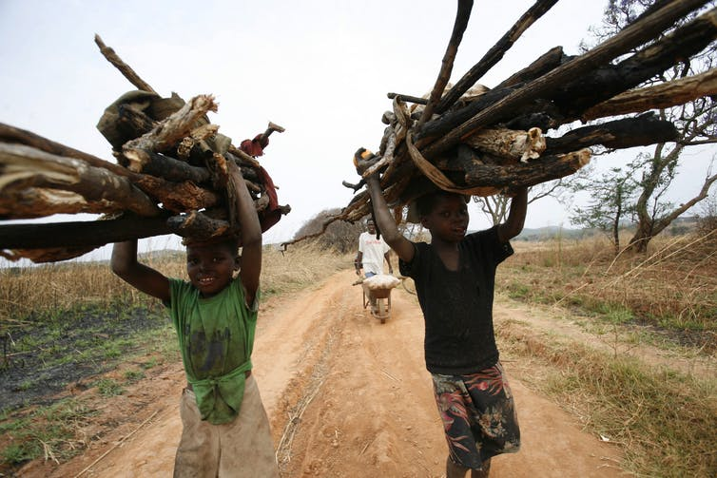
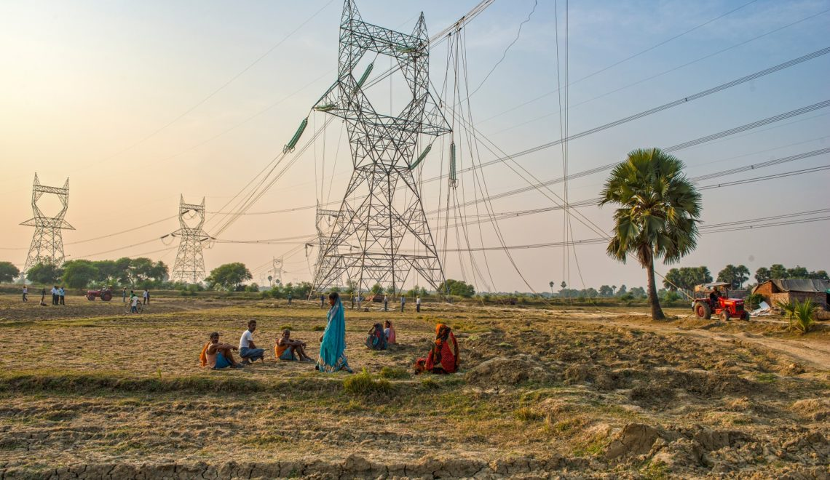
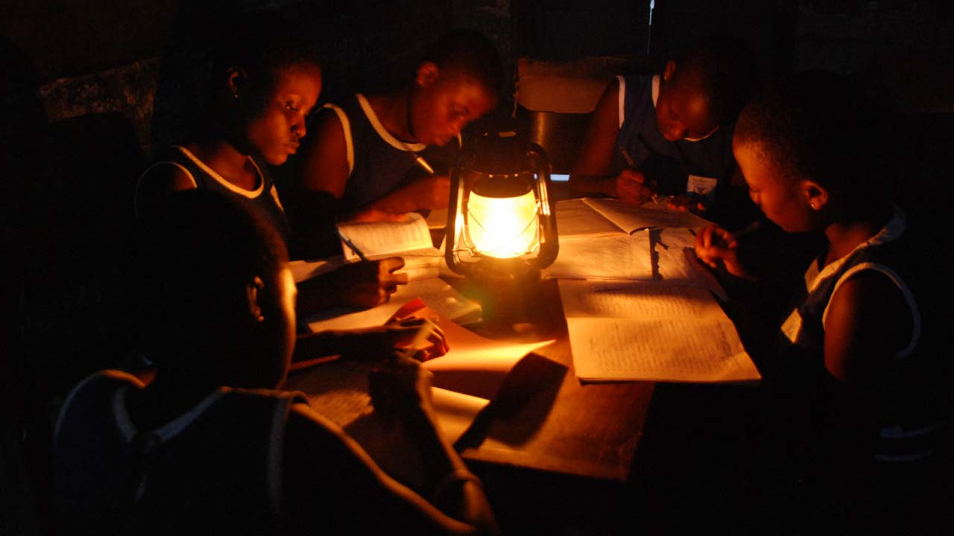
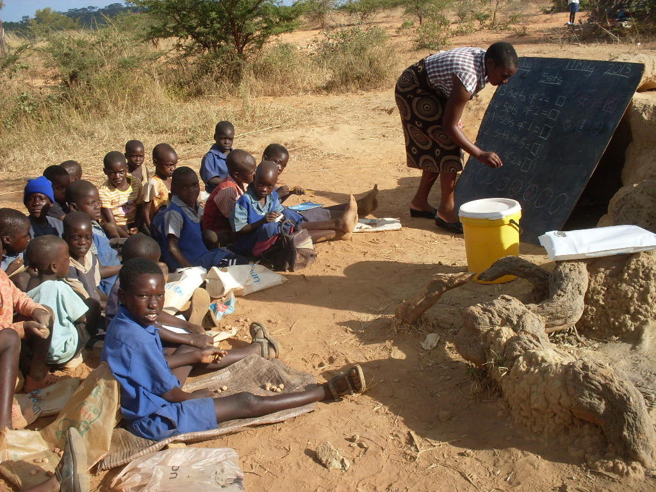
759 Million people in the world have no access to electricity, 75% of which is African population (World Bank, IRENA, UNDESA, WHO, 2019)
PROBLEM 1: ACCESS ISSUE
80-90 % of the rural population in Zimbabwe have no access to electricity. Since its inception in 2002, the REA has only managed to electrify 5% of the rural households (World Bank, 2020). This makes the waiting period to access electricity long
PROBLEM 2: COST ISSUE
Access to electricity in rural areas is extremely low due to the prohibitive costs of extending national electricity grids, vis-à-vis disposable income of rural folks (UNEP, 2019).
PROBLEM 3: CLIMATE CHANGE ISSUES
Unsustainable fuelwood use patterns in rural Zimbabwe are driving deforestation which poses an environmental hazard (Global Warming) in the long run. Rural communities in Zimbabwe meet 94% of their cooking energy requirements by using traditional fuels, mainly fuelwood which translate to 330,000 hectares of forests destroyed per annum (The Forestry Commission of Zimbabwe, 2020)
PROBLEM 5: ACCESS TO REMOTE LEARNING/TECHNOLOGY
The effects of lack of access to electricity on education was more evident recently when schools were closed amid lockdown measures due to Covid. Access to remote learning was limited in rural areas, especially for poor households. Only 9 percent of school-going children in rural areas were reported as having used mobile applications for learning during pandemic-related school closures, compared with 40 percent for urban children (UNICEF, 2021).
PROBLEM 6: HEALTH ISSUES
Kerosene lighting lamps are widely used in rural Zimbabwe, yet they are extremely inefficient, dangerous and expensive, and it has extensive health and environmental drawbacks (Melik, 2012). The World Bank estimates that breathing kerosene fumes is the equivalent of smoking two packets of cigarettes a day and two-thirds of adult females with lung cancer in developing nations are non-smokers
PROBLEM 4: POVERTY
Rural households rely on farm business for survival, thus the lack of access to electricity hinders socio-economic activities such as irrigation, processing and manufacturing, and other value addition agricultural activities carried out in rural areas. This negatively affects the quality of people’s life. According to the World Bank, 2021, 49% of Zimbabwe’s population lives in extreme poverty of which 90% is the rural population

Slide 5
STAKEHOLDER ANALYSIS
Rural Households | Zimbabwe Electricity Supply Authority (ZESA) | Rural Electrification Agency (REA) | Ministry of Environment, Climate Change, Tourism and Hospitality Industry | Potential Funders Potential Partner Service Providers
This is the target population, which forms 67% of the 14.86 million people in Zimbabwe Rural households rely on farm business for survival Firewood, Kerosene, Candles are the main sources of energy and lighting Source: UN, 2021 | ZESA which, through its subsidiaries Zimbabwe Power Company (ZPC), and the Zimbabwe Electricity Transmission and Distribution Company (ZETDC), generate, import and distribute all electrical energy in the country. For many years, the company has failed to produce enough energy to meet demands. Evident in the 12-hour daily power cuts in urban areas (Marawanyika, 2021) | Incepted in 2002 under the Ministry of Energy & Power, the REA’s sole mandate is to electrify the countryside/rural areas. Nonetheless since its inceptions the REA has only managed to electrify thousands of schools and rural health centers. Yet few power lines extend beyond institutional buildings, with only about 5% of rural villages electrified. Source: World Bank, 2020 | The Government wing responsible for; sustainable environmental and natural resources management for socio-economic development. Planning, R&D and developing environmental and natural resources policies and legislation Promoting the adoption of appropriate and proven natural resources management techniques and profitable use of these resources on a sustainable basis Promoting stakeholder and public participation in integrated programmes of environmental, forestry and wildlife management Source: Veritas, 2020 | Social Innovation Crowd funding platforms e.g., Start Some Good , Catalyst , Chuffed, Go Fund Me (More than 9 billion raised), Kickstarter (More that 6.2 billion raised)etc. AGRIBANK 1st World Doners/Sponsors Other potential partners and funders. Internet Service Providers e.g., Econet, Telcel, Net one Solar Panels and other technological manufacturers e.g., Huawei with its Solar Panel, Inverter, battery and Wi-Fi device Combo

Slide 6
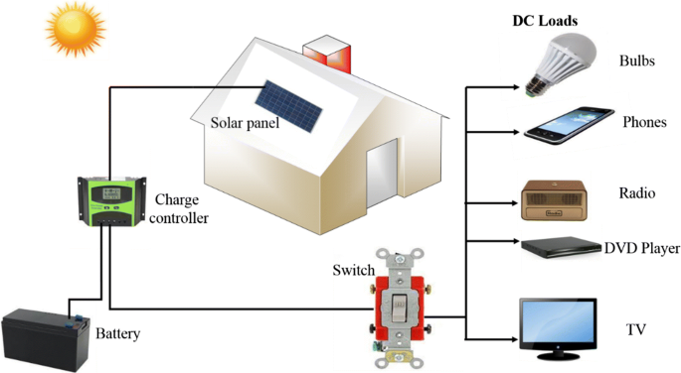
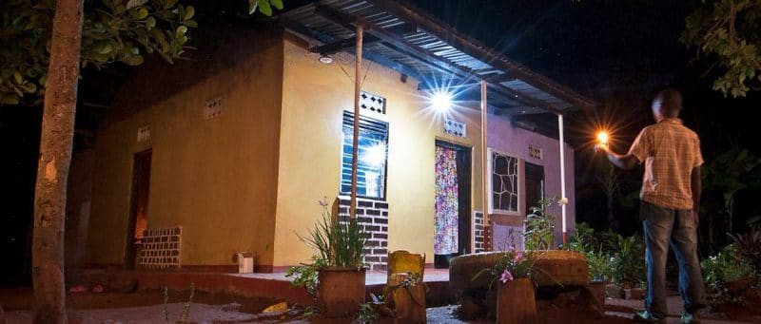
PROPOSED SOCIAL INNOVATION REMEDIES:
1. THE PRODUCT - HOUSEHOLD
This need-pull social innovation strategy proposes the Harnessing of the RENEWABLE power of the sun, to UPLIFT and SUSTAIN the livelihoods of rural households in Zimbabwe.
The unit will come as a bundle product i.e.; The Solar Panel, Inverter for the conversion of AC to DC power, Battery for electricity storage, A Wi-Fi Device (modem, router or mbb), bulbs, ports for mobile charging, an electronic device (tablet/phone). Optional DC devices includes but are not limited to devices illustrated above.
Renewable clean power that is available every day of the year, even cloudy days produce some power. It also facilitates and promotes socio-economic activities, access to e-learning, curb deforestation, reduce dependence on foreign oil, fuelwood, and fossil fuels, no maintenance as solar panels last over 30 years.

Slide 7
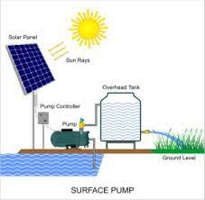
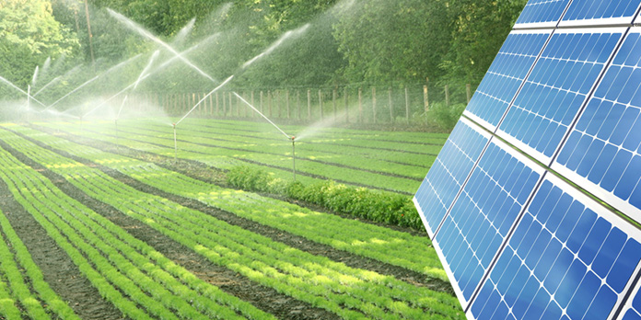
PROPOSED SOCIAL INNOVATION REMEDIES:
1. THE PRODUCT - AGRICULTURE
The rural population relies on agricultural activities for survival rather than wages, hence this need-pull social innovation strategy proposes the acquisition and installation Solar-Powered irrigation systems (SPIS) in the rural areas of Zimbabwe. This will curb effects of draught, promote the value-added agricultural activities in rural areas, and can increase agricultural produce by 50%.
Using renewable energy in pumping and irrigation can therefore not only reduce greenhouse gas emissions, but also lower the costs of buying diesel or kerosene fuels and increase the sources of income for large and small-scale farmers

Slide 8
PROPOSED SOCIAL INNOVATION REMEDIES:
2. THE PROCESS - FINANCING
ADDRESSING THE COST ISSUE : DONATIONS AND FUNDRAISING | RENT TO BUY – AGRIBANK PARTNERSHIPS | SERVICE PROVIDER- PARTNERSHIPS | GOVERNMENT: ZESA & REA
This project will source funds through well wishers (mostly 1st world population) to Donate funds/Solar Units to 3rd World country towards the Rural Electrification Initiative. This will be facilitated through; Website Monetary Donations, Direct Purchase and Supply of Inputs, Fundraising through the website, Join the monthly giving club. Engage the Social Innovation Crowd funding platforms e.g., Start Some Good , Catalyst , Chuffed, Go Fund Me (More than 9 billion raised), Kickstarter (More that 6.2 billion raised)etc. We will make use of these platforms to try and raise funds toward rural electrification. It is estimated that in 2017, at least USD 13.7 million was raised through crowdfunding platforms for energy access, up nearly 60% from 2016 levels (UNDP, 2018). Approach 1st World Electrification companies and seek donations through dedicating a certain percentage of electricity payments towards rural 3rd World electrification. Local Fundraising and engagement with the local businesses, Environmental organizations, Non-Governmental and Government organizations. | Agribank is a commercial Agricultural Development Bank of Zimbabwe earmarked to provide finance to farmers in line with the government's land reorganization strategy For sustainability and self-financing, it is also proposed that rural household may purchase their own units on a Rent-To- Buy Basis. Taking into consideration that agricultural proceeds are seasonal, this payment plan facilitates periodic instalments over a period, hence lessening the affordability burden. Partnering with Agribank to provide rural households/ farmers access to commercial debt financing in large volumes and the pay-as-you-go solar units at low or no interest rates, payable from agricultural and other value-added agricultural activities produce resultant from Solar irrigations. The above suggestions are inline with the government 2030 Vision to realize an Upper- Middle economy through the Uplifting the country’s livelihoods. | Synergies with the likes of Econet and Netone to provide affordable Wi-Fi bundle products inline with their social responsibility core values. Arrange for periodic instalments through mobile money. Fundraising through established service providers brands. Seek donations through dedicating a certain percentage of their airtime purchase towards rural electrification. Partnership with Huawei for the supply of their Solar Panels, Inverters, Battery, Modem and Tablets. | Through its wings responsible for the National Electrification (ZESA) and Rural Electrification (REA), engage the government and leverage the Rural Electrification Fund (REF) whose mandate is to facilitate rapid and equitable electrification of all the rural areas of Zimbabwe through the conventional grid network and other renewable energy technologies such as solar and biogas (https://rea.co.zw/our-mandate/)

Slide 9
THE MODEL
 | UPSTREAM PROCESS | PRODUCTION PROCESS | DOWNSTREAM PROCESS
Solar Panels
Solar Photovoltaic
Solar Thermal
Rural Households
Agricultural activities
Income (Rent to Buy):
Sales, distribution, installations, accessories
Servicing, maintenance, tracking, & Repairs
Fittings, Installation, Commissioning,
Conversion Process
System Design and Engineering
Electricity
Heat
Fundraising
Sponsorships
PV Modules, inverters, control panels etc.
Operational/Labor Costs

Slide 10
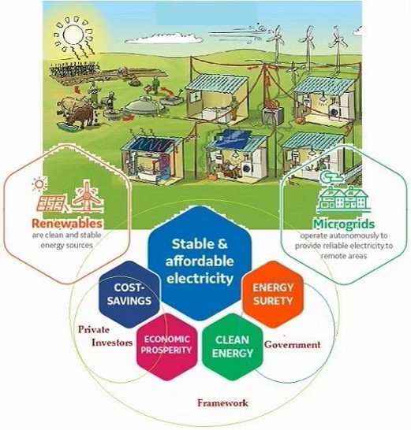
Sustainable Energy Framework

Slide 11
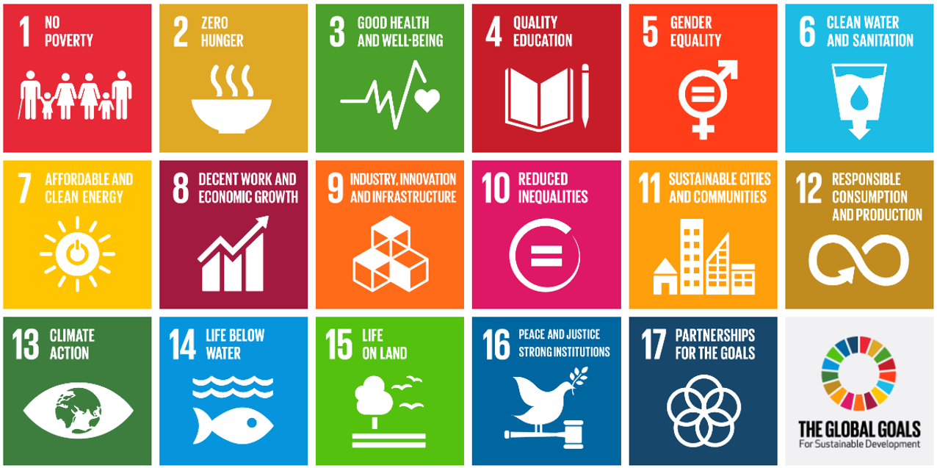
MOTIVATION – RURAL SUSTAINABLE DEVELOPMENT
This initiative is aimed at bringing about qualitative, quantitative and sustainable positive change that improves the quality of life and economic wellbeing of the rural population in Zimbabwe through the facilitation and provision of Solar Energy. This is line with the United Nations’ Sustainable Development Goals (SDGs), particularly, SDG 7 (Affordable & Clean Energy) and SDG13 (Climate Action). The Zimbabwe National Development Strategy (NDS 2030) also seeks to attain a Prosperous & Empowered Upper Middle-Income Society by 2030. This includes sustainable economic growth, employment creation, wealth creation, and poverty alleviation
UNITED NATIONS SUSTAINABLE DEVELOPMENT GOALS |  | NATIONAL DEVELOPMENT STRATEGY (NDS 2030)
SDG 7: AFFORDABLE AND CLEAN ENERGY In line with this SDG, this initiative seeks to eradicate the use of dangerous and inefficient cooking systems is rural areas. This includes the use of firewood, kerosene and other foreign oils. Access to Clean, Renewable Cost-Effective Solar Energy, accelerates access to Modern Renewable Energy, thus improving socio-economic activities in rural areas The World Bank estimates that breathing kerosene fumes is the equivalent of smoking two packets of cigarettes a day and two-thirds of adult females with lung cancer in developing nations are non-smokers | SDG 13: CLIMATE ACTION In line with the Global urgency to combat Climate Change crisis, this initiative with the use of Renewable Solar energy combats the impact of Deforestation currently rampant in Zimbabwe. Rural communities in Zimbabwe meet 94% of their cooking energy requirements by using traditional fuels, mainly fuelwood which translate to 330,000 hectares of forests destroyed per annum (The Forestry Commission of Zimbabwe, 2020). This have serious adverse environmental effects not to mention the dangerous effects resulting from the emission of carbon monoxide from firewood and kerosene in the ozone layer. | NDS is to attain a Prosperous & Empowered Upper Middle-Income Society by 2030. This includes sustainable economic growth, employment creation, wealth creation, and poverty alleviation. Nonetheless achieving some of these goals are faced with economical challenges. For instance, the REA since its inception in 2002 (20 years later) it has only managed to electrify 5% of the rural households. This initiative therefore seeks to bridge this gap and aid to the NDS 2030. 67% (more that 2/3) of the Zimbabwean population resides in the rural areas, hence it is equally important to ensure these total rural electrification is achieved towards the nation’s NDS. The country’s leading industrial sectors are the mining and agricultural sectors, of which agricultural is highly concentrated in the rural areas, thus making rural electrification an urgent issue towards economic growth.

Slide 12
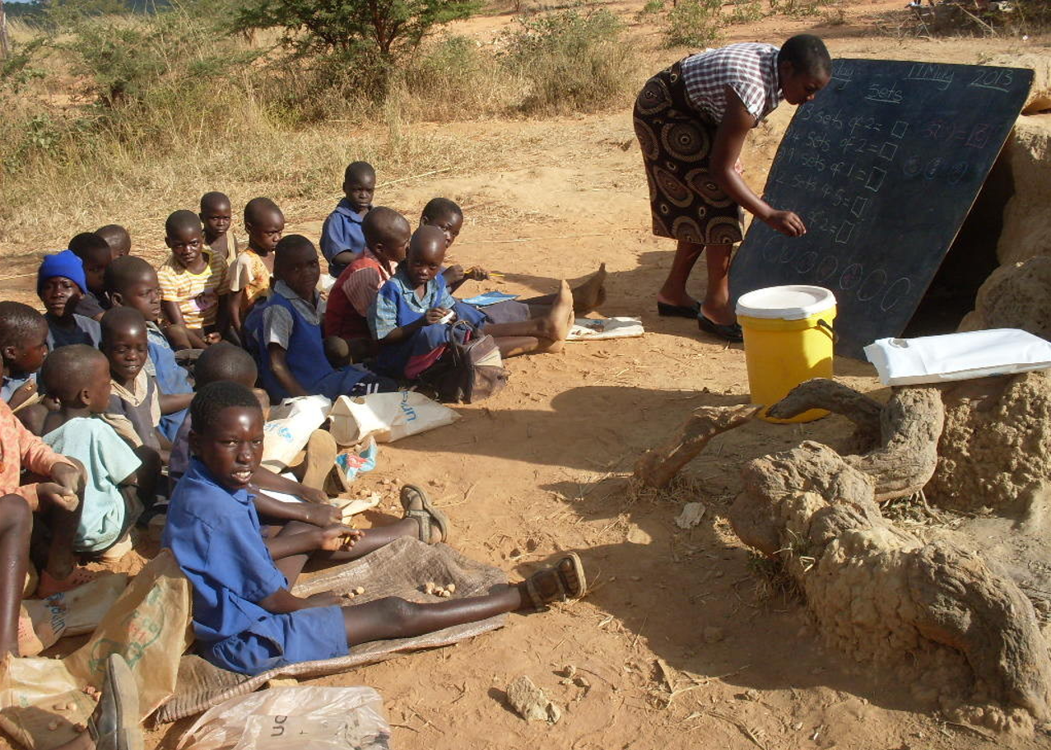
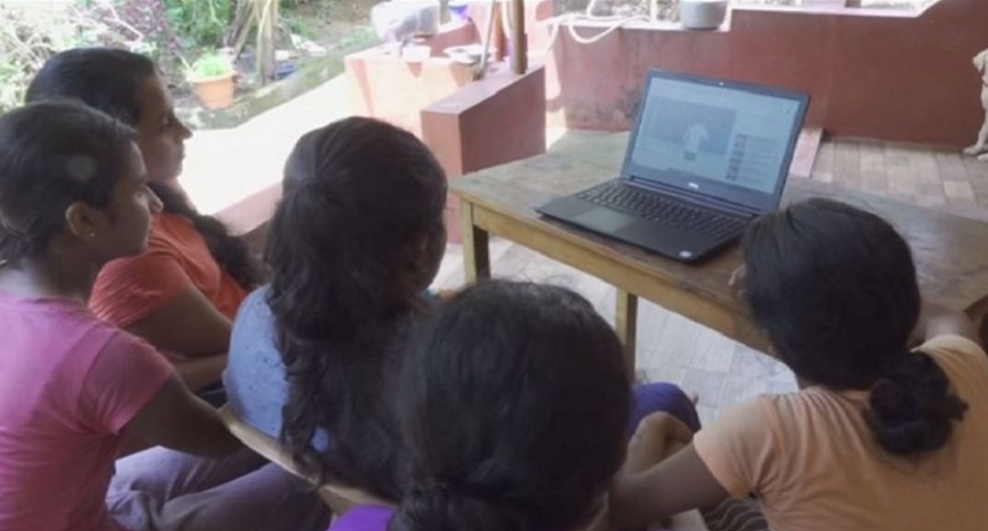
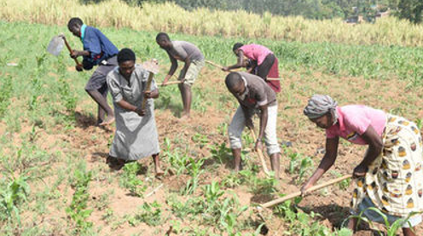
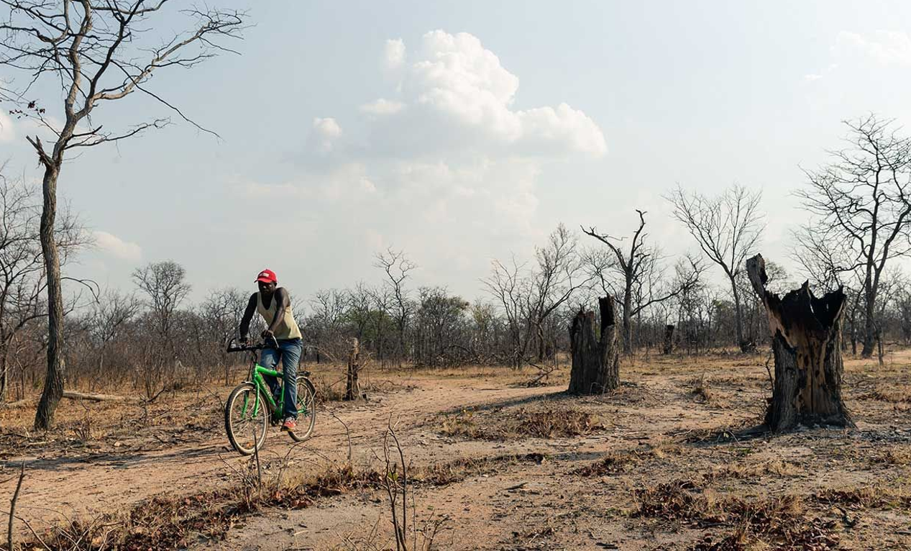
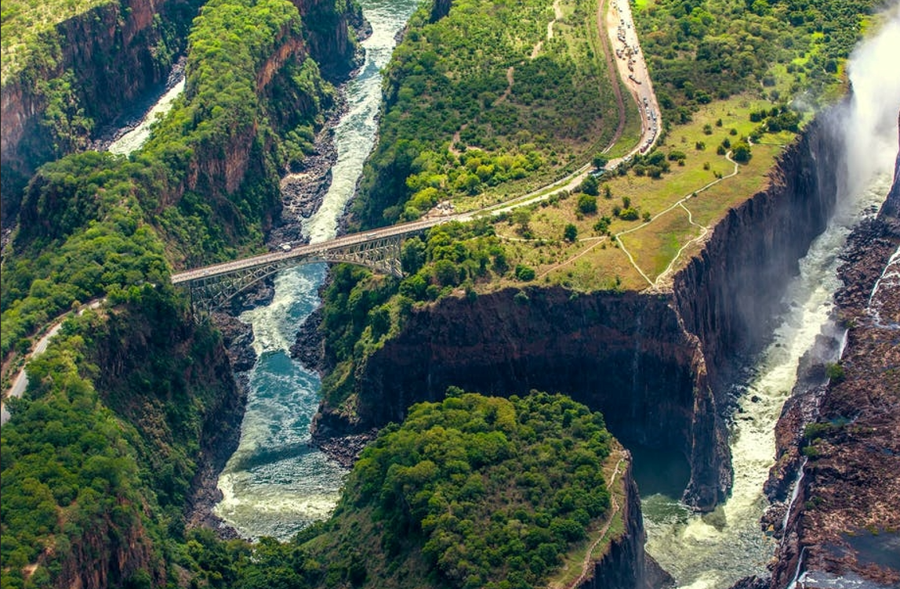
CONCLUSIONS: NEED PULL SOCIAL INNOVATION

Slide 13
REFERENCES
Global Forest Watch. (2021). Tree Cover Loss In Gokwe South, Midlands, Zimbabwe. www.globalforestwatch.org/
MSD (Meteorological Services Department of Zimbabwe). (2021). Monthly Weather Reports By Province.
The Forestry Commission of Zimbabwe. (2020). Forest Information System. Land Cover Map 2017. http://www.forestry.co.zw/research-training-introduction/forestinformationsystem/
UN (United Nations). The 2030 Agenda and the Sustainable Development Goals. https://sdgs.un.org/goals
UNEP (United Nations Environment Programme). (2019). Energy Profile – Zimbabwe. https://www.unep.org/resources/report/energy-profile-zimbabwe
UNDP (United Nations Development Programme) (2018), “Financing solutions for sustainable development”, http://www.undp.org/content/sdfinance/en/home/solutions/template-fiche12.html
UNICEF (United Nations Children’s Fund). (2021). Remote Learning and Digital Connectivity. https://data.unicef.org/topic/education/remote-learning-and-digital-connectivity/
United Nations Zimbabwe. (2021). The United Nations Common Country Analysis 2021. UN Resident Coordinator’s Office – Zimbabwe. https://zimbabwe.un.org/en/130569-zimbabwe-un-common-country-analysis-2021
World Bank. (2020). Access to Electricity By Population (%) – Zimbabwe. https://data.worldbank.org/indicator/EG.ELC.ACCS.ZS?locations=ZW
World Bank. (2021). The World Bank in Zimbabwe. https://www.worldbank.org/en/country/zimbabwe/overview#1
Zimbabwe National Statistics Agency. (2012). Zimbabwe Population Census 2012. Provincial Report Midlands. Population Census Office. https://www.zimstat.co.zw/wp-content/uploads/publications/Population/population/Midlands.pdf

